Slide 1
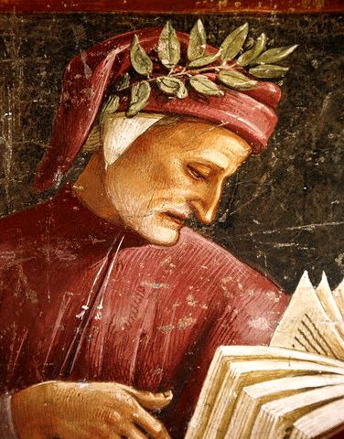

University of Milano - Bicocca
Master of Science in Data Science
Academic Year 2021/2022
THE EVOLUTION OF TÓPOI IN THE ITALIAN LITERARY TRADITION
Authors:
Giorgio CARBONE no. 811974
Gianluca CAVALLARO no. 826049
Remo MARCONZINI no. 883256

Slide 2
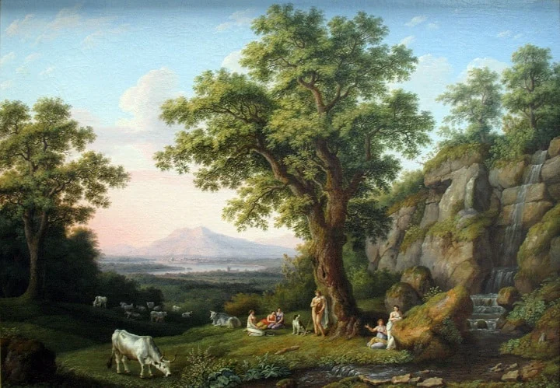
/ The literary topos
Literary themes:
Tòpos: ‘commonplace’
Repertoire of thematic and formal constants in Western and Italian literature
Tópoi as a tool for passing on the literary tradition
Theópoi go through history and literary phases, but change in form and interpretation

Slide 3
/ Objectives and research questions
Objectives:
Generating corpora from a collection of texts obtained from heterogeneous sources
Learning word embeddings from cropora generated and processed, using word2vec and CADE
Analysing some particularly long-lived types
Research questions:
How do literary themes change in history?
How Do Literary Currents Shape Themes?
Given some peculiar tòpos of the great authors, what do they correspond to in the works of other authors?

Slide 4
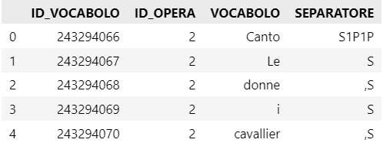
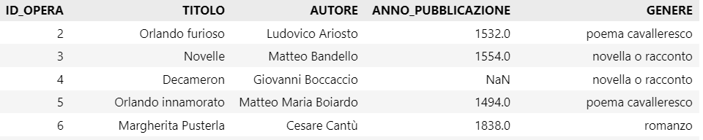
/ The data: the SCRIPTA language corpus
The main data source was the SCRIPTA linguistic corpus of Prof. Michele Giordano
3111 texts of Italian literature, published between 1224 and 1922
736 unique authors
133,000,000 words
Supplemented with texts after 1922

Slide 5
/ Workflow
Data integration
Data augmentation
Generation of corpora collections
Reconstruction of texts from the SCRIPTA vocabulary
Subdivision into different corpora collections
Corpora preprocessing
Model training
Analysis

Slide 6
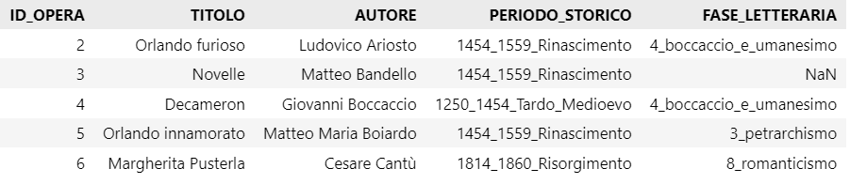
/ Data integration and data augmentation
Data integration
Integration of SCRIPTA tables on authors, genres and works
Selection and integration of 72 novels published after 1922
Data augmentation works
Definition of the historical period of publication
Definition of literary current/phase

Slide 7
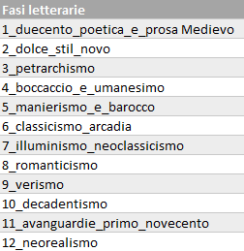
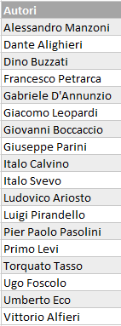
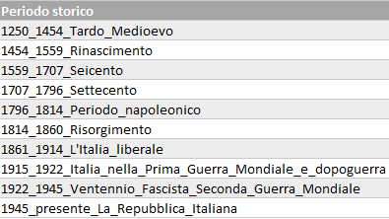
/ Generation of corpora collections
Text regeneration from words
Creation of 3 corpora collections
Corpora of texts by historical period
Corpora of texts by literary phase/current
Corpora of texts produced by some important authors

Slide 8
/ Pre-processing
For each corpus generated, the following pre-processing operations were performed:
Tokenisation
Conversion to lower case
Removal of non-alphanumeric characters
Removal of punctuation
Removing stopwords
List extension [6]
Problem archaic forms

Slide 9
/ Lemmatisation
Several Python libraries available
NLTK
Spacy
Simplema
Comparison of pre-processing results with and without lemmatisation
Using all libraries
Corpus sampling
Analysis of results
Total number of words
Number of unique words
Most frequent words

Slide 10
/ Lemmatisation
Without lemmatisation
Pre-processing with lemmatisation w/NLTK
Results similar to pre-processing without lemmatisation
Pre-processing with lemmatisation w/Simplemma
Fewer total words
Drastic reduction in the number of unique words
Pre-processing with lemmatisation w/Spacy
Fewer total words
Drastic reduction in the number of unique words
Lemmatisation with NLTK
Lemmatisation with Simplemma
Lemmatisation with SpaCy

Slide 11
/ Lemmatisation
NLTK
Invariance of the number of total and unique words compared to non-lemmatising
Same frequent words compared to non-lemmatising
Spacy and Simplemma
It returns verbs to their infinitive form which become the most frequent
Reducing the relative frequency of useful words for subsequent analysis
Adopted libraries
Reliability problem
For the Italian language
Problem Evolution of the Italian Language
For these reasons we decided to proceed without lemmatising

Slide 12
/ Generation of Bigrams
Motivation:
Some topos are difficult to represent with a single word
Word2Vec only accepts uni-grams
Gensim Bookshop
Generation by the Phrases method [8]
Does not consider language
Consider the frequency of juxtaposed words

Slide 13
/ Generation of Bigrams
For each different subdivision of the text collection
Union of all texts into one corpus
Bi-gram generation over the entire corpus
Increased consistency of bi-grams generated
Using bi-grams identified in the pre-processing phase
Training of Word2Vec and CADE models:
No improvement in results
Display of results without considering bi-grams

Slide 14
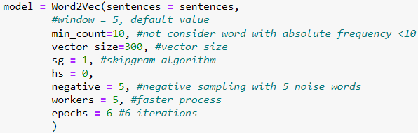
/ Model training
Corpus processed without bi-grams
Both unaligned and aligned models are created, using Word2Vec and CADE algorithms
By nature, word embeddings are stochastic: to get more reliable results we decide to train 5 word embeddings for each corpus by combining the results
We use the Skip-Gram method, which is best suited to semantic tasks [2].
The Skip-Gram Negative Sampling strategy was used, generally preferred for its greater reliability in handling infrequent words
Based on [4], the values of the remaining parameters were selected

Slide 15
/ Question 1 and 2
How do the most enduring literary themes change in different historical periods? Does the cultural-historical context influence the recurring themes?
How do the canons of the different literary currents in Italian literature shape the representation of these common themes?

Slide 16
/ Question 1 and 2 - considerations
Analysis conducted on both unaligned and CADE-aligned corpora. The results obtained on the unaligned models are shown, as they are more significant
The tòpos were analysed both through different literary currents and historical periods
The analysis was conducted from a set of several words for each tòpos

Slide 17
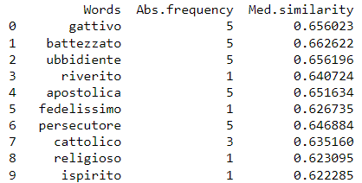
/ The shepherd's tòpos
Search word: shepherd
Interesting conclusions from the analysis across historical periods
The figure of the shepherd is linked as much to the rural as to the religious world
In the late Middle Ages, the words most similar to shepherd are related to the religious sphere
Late Middle Ages

Slide 18
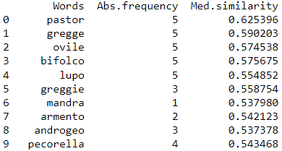
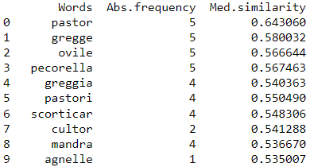
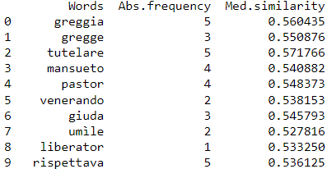
/ The shepherd's tòpos
Subsequently, the figure of the shepherd began to be associated with the rural world. Interesting adjectives appear such as hillbilly, humble and meek
Renaissance
Six hundred
Eighteenth century

Slide 19
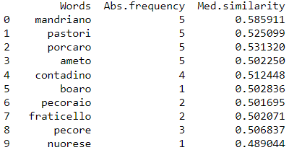
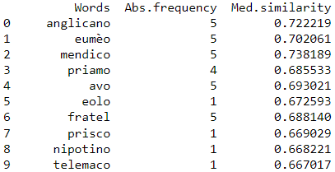
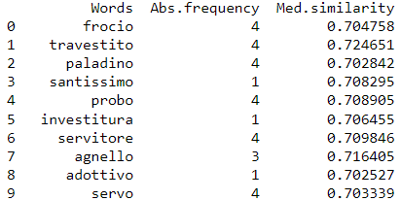
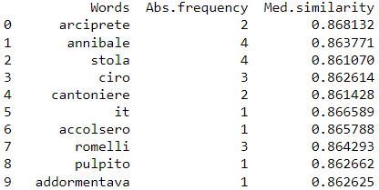
/ The shepherd's tòpos
In more recent periods, there is a return to the religious sphere. More derogatory adjectives such as swineherd, sheepherder and servant appear, up to faggot and transvestite
Liberal Italy
World War I
The presence of eumèo, the 'faithful swineherd of Ulysses', is interesting
After the Second World War
Twenty years of Fascism

Slide 20
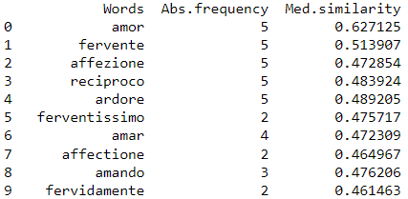
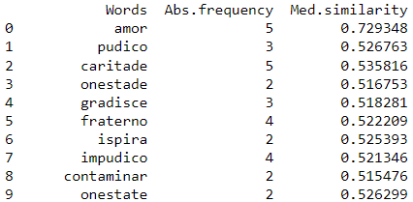
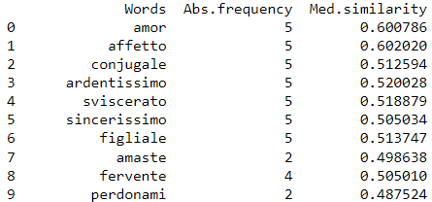
/ The tòpos of love
Search word: love
Interesting conclusions from the analysis across both historical periods and literary currents
From a historical perspective, one can see how love is described as an ardent, fervent and honest feeling
Renaissance
Six hundred
Risorgimento

Slide 21
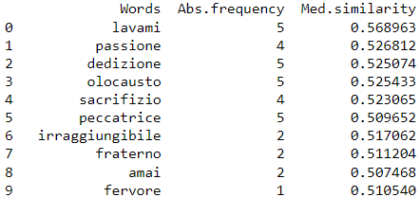
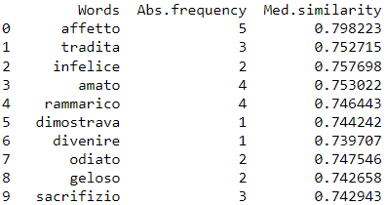
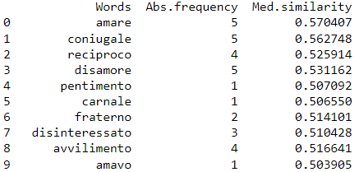
/ The tòpos of love
From the First World War onwards, negative feelings are also associated with unhappiness, jealousy, betrayal and repentance
Interestingly, in the period of the First World War, love is associated with the holocaust
World War I and the early post-war period
Twenty years of Fascism
After the Second World War

Slide 22
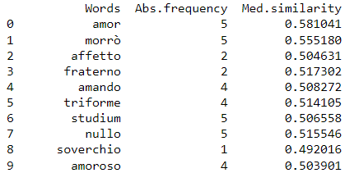
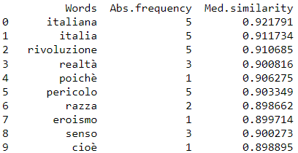
/ The tòpos of love
Even in different literary currents, love continues to be described as ardent, fervent and honest
Two interesting aspects:
In decadentism, the word morrò appears, a sign of a love so intense that it can lead to death
In the avant-garde of the early 20th century, love acquired connotations linked to race and Italy
Decadentism
Early 20th century avant-gardes

Slide 23
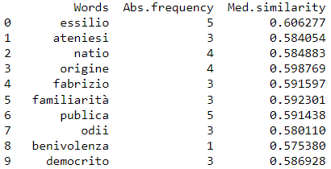
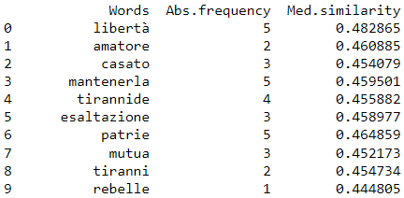
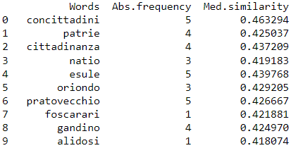
/ The homeland tòpos
Search word: homeland, nation, flag
Interesting conclusions from the analysis across historical periods
Clear difference between the period before and after Italian unification
Before 1861, the concept of homeland was linked to those of exile, freedom and citizenship
Full Middle Ages
Renaissance
Eighteenth century

Slide 24
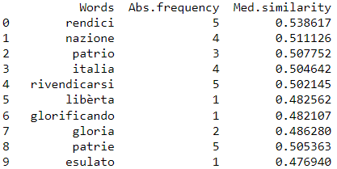
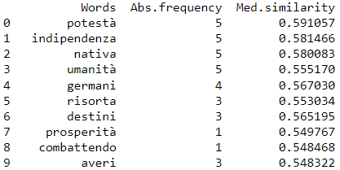
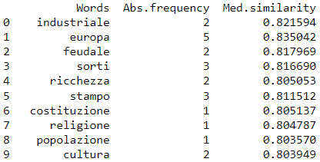
/ The homeland tòpos
After the creation of the Kingdom of Italy, among the most similar terms appear Italy, Europe and a number of words related to the political sphere
Liberal Italy
World War I and the early post-war period
Twenty years of Fascism
Interesting appearance of the topic of parental authority

Slide 25
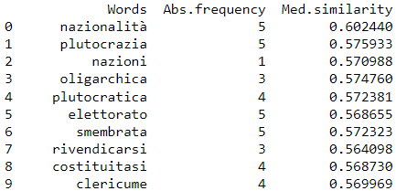
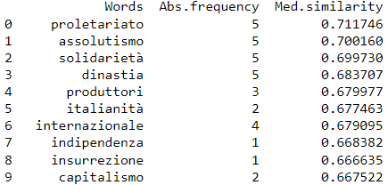
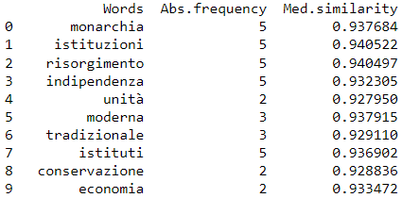
/ The homeland tòpos
The previous themes are also found by searching for the word nation
Liberal Italy
World War I and the early post-war period
Twenty years of Fascism

Slide 26
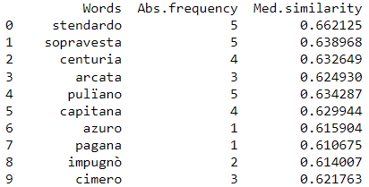
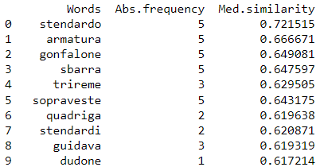
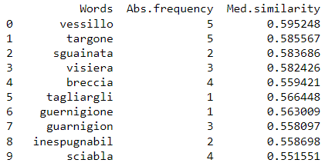
/ The homeland tòpos
The flag also changed meaning with the creation of the Kingdom of Italy. Before 1861 it was a banner, a standard to be displayed in battle...
Renaissance
Six hundred
Eighteenth century

Slide 27
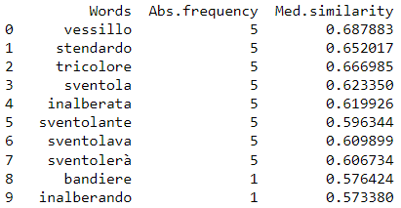
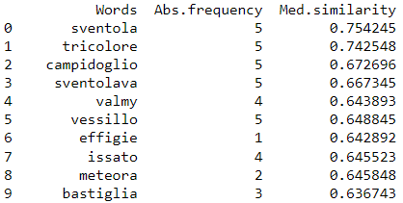
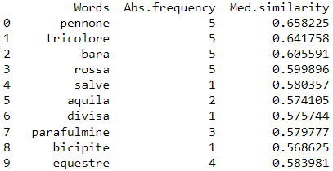
/ The homeland tòpos
... then it is associated with the waving tricolour
In the more recent period, the presence of the red flag, a communist symbol, is also noticeable.
Liberal Italy
World War I and the early post-war period
After the Second World War

Slide 28
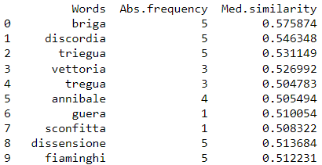
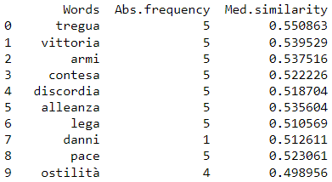
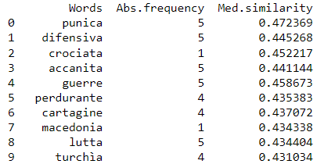
/ The tòpos of war
Search word: war
Interesting conclusions from the analysis across historical periods
Still the unification of Italy as a watershed
Until then, stories are told of victories and defeats, exploits and truces
References to wars characteristic of a certain historical period also appear
Late Middle Ages
Napoleonic period
Risorgimento
Interesting return to the narrative of the Punic Wars

Slide 29
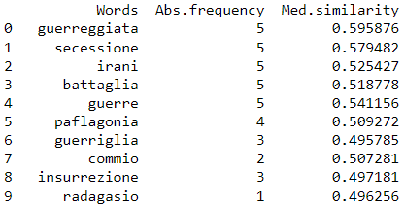
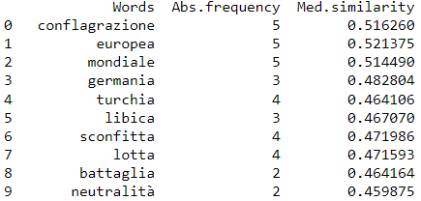
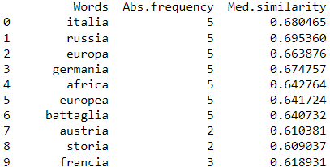
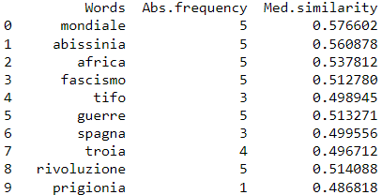
/ The tòpos of war
Liberal Italy
World War I, post-World War I and World War II
With the unification of Italy comes secession, guerrilla warfare and insurrections
The word world appears, in addition to the nations that played a leading role in the war scenario of the period
After the Second World War
The war in Abyssinia and Fascism holds sway

Slide 30
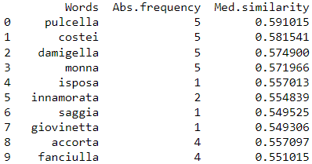
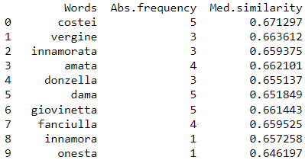
/ The woman's tòpos
Search word: woman
Interesting conclusions from the analysis across literary currents
Humanism
In humanism, woman is a chick, a wise and shrewd young girl
In the Baroque period, woman is portrayed as a virgin and honest figure
Baroque

Slide 31
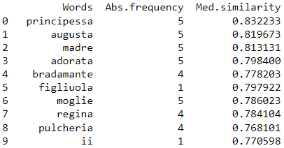


/ The woman's tòpos
Classicism recovers the figure of the princess and queen
In the Enlightenment period, women are excellent, attractive and virtuous
In Romanticism, the figure of the woman is associated with Prassede, a character from The Betrothed who is extremely bigoted and demure
Classicism
Enlightenment
Romanticism

Slide 32
/ Question 1 and 2 - conclusions
Interesting conclusions for some literary tòpos
The tòpos shown are the simplest ones, easily connoted from a historical or literary point of view
Despite numerous attempts, no interesting conclusions have been reached on more complex tòpos
The extremely varied content of each corpus made it complicated to identify specific characteristics for complex tòpos
A more specific choice of books and a more accurate subdivision of the corpus could lead to better results

Slide 33
/ Question 3
Is it possible, using aligned corpuses of various authors from the Italian literary tradition, to identify correspondences between peculiar tópoi or concepts?

Slide 34
/ Question 2 - considerations
Analysis conducted considering the corpora of several authors aligned via CADE
For each author, the most representative concepts and characters were evaluated

Slide 35

/ Pirandello's mask
For Luigi Pirandello, the mask is associated with the shattering of the ego and the adaptation of the individual according to the context in which he finds himself
You can see how the mask is shapeless and insubstantial
Luigi Pirandello

Slide 36










/ Pirandello's mask
In other authors, the Pirandellian mask becomes a figure, a stain, a shell. It is compact, impenetrable and often denotes feelings of jealousy and inferiority
Dante Alighieri
Dino Buzzati
Francis Petrarch
Gabriele D'Annunzio
Giacomo Leopardi
Italo Calvino
Italo Svevo
Pier Paolo Pasolini
Torquato Tasso
Vittorio Alfieri

Slide 37

/ Manzoni's Bravi
Bravi is a familiar name from The Betrothed: in the 16th and 17th centuries, thugs in the service of lords, often executors of orders and crimes, were so called
Alessandro Manzoni

Slide 38






/ Manzoni's Bravi
For other authors, the good continue to be servants, helpers, in some cases called mules or mastiffs
Very interesting correspondence for Primo Levi: the good become the officers and soldiers of the Auschwitz concentration camp
Dino Buzzati
Giacomo Leopardi
Luigi Pirandello
Primo Levi
Ugo Foscolo
Vittorio Alfieri

Slide 39
/ Question 2 - conclusions
Despite some matches, the analysis yielded unsatisfactory results
It was not possible to establish correspondences between characters
Probably, a deeper knowledge of each author's thought would allow better identification of characters and concepts to be analysed for more meaningful results

Slide 40
/ Conclusions and future developments
Conclusions
The analyses conducted did not lead to the desired results
The very varied corpuses have complicated the identification of the characteristics of the different tòpos, especially for the more complex ones
A more restrictive selection of texts and a more judicious division of books into different historical and literary periods could lead to more meaningful conclusions
Future developments
Use of different algorithms, methods and parameters for training models
Deepening the use of word phrases in models
Improvement of corpus quality with targeted operations, for example:
Improving Old Italian Language Management (expanding the list of stopwords)
Use of paraphrases for older texts

Slide 41
/ Bibliographic references
Compass-Aligned Distributional Embeddings For Studying Semantic Differences Across Corpora - Bianchi F., Di Carlo V., Nicoli P. and Palmonari M.
Survey of Computational Approaches to Lexical Semantic Change: https://arxiv.org/abs/1811.06278
SCRIPTA: literary language corpus: https://parolescritte.it
50 tòpoi in Italian literature: http://www.letteratura-italiana.com/pdf/letteratura%20italiana/13%2050%20topoi%20della%20letteratura%20italiana.pdf
Genesini Pietro, Italian Literature 123, Padua, 2022 URL: http://www.letteratura-italiana.com/pdf/letteratura%20italiana/01%20GENESINI%20Letteratura%20123.pdf
Extension of the stopword list. URL: https://raw.githubusercontent.com/stopwords-iso/stopwords-it/master/stopwords-it.txt
History of Italian Literature URL: https://it.wikipedia.org/wiki/Storia_della_letteratura_italiana
Learning Embeddings For More Than One Word: https://towardsdatascience.com/word2vec-for-phrases-learning-embeddings-for-more-than-one-word-727b6cf723cf

